Slide 1


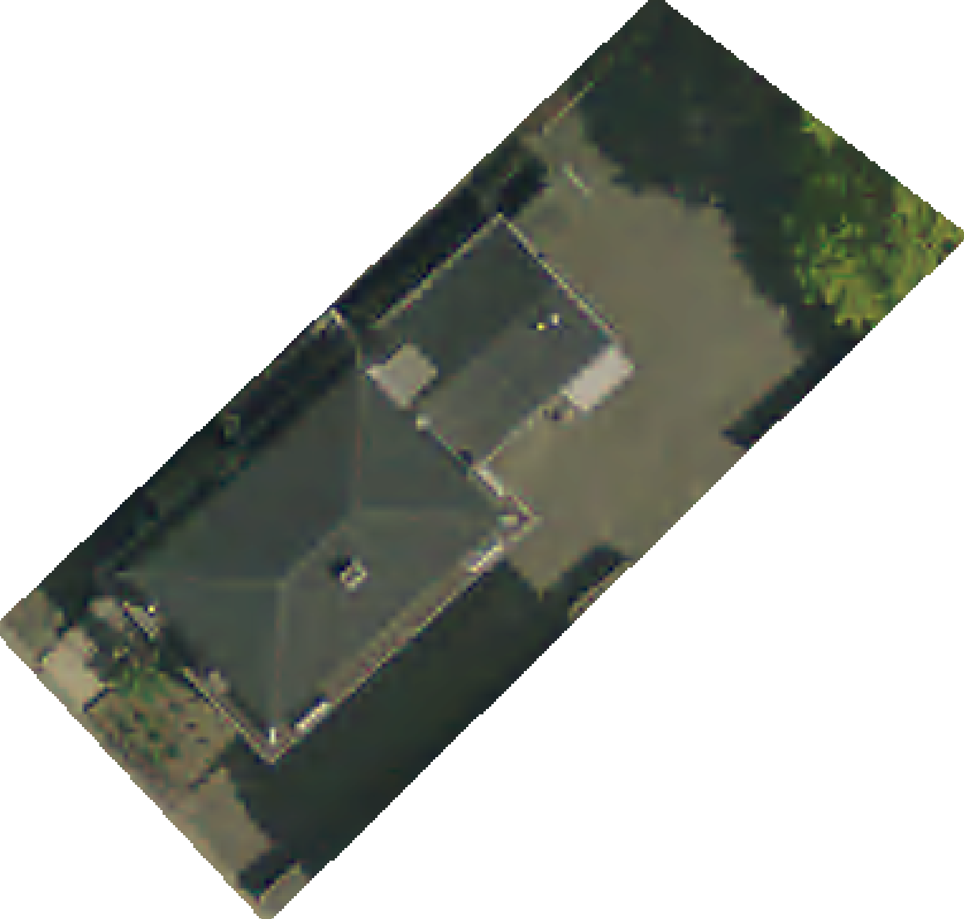
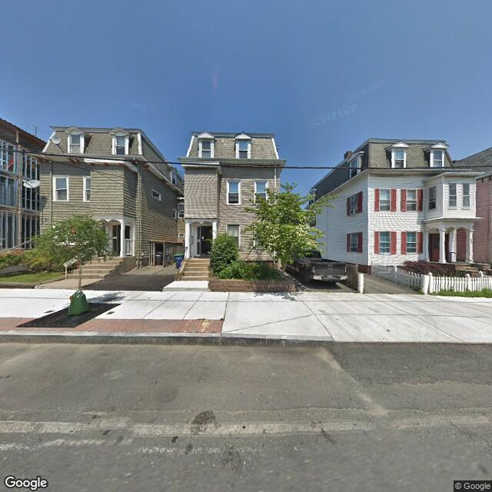
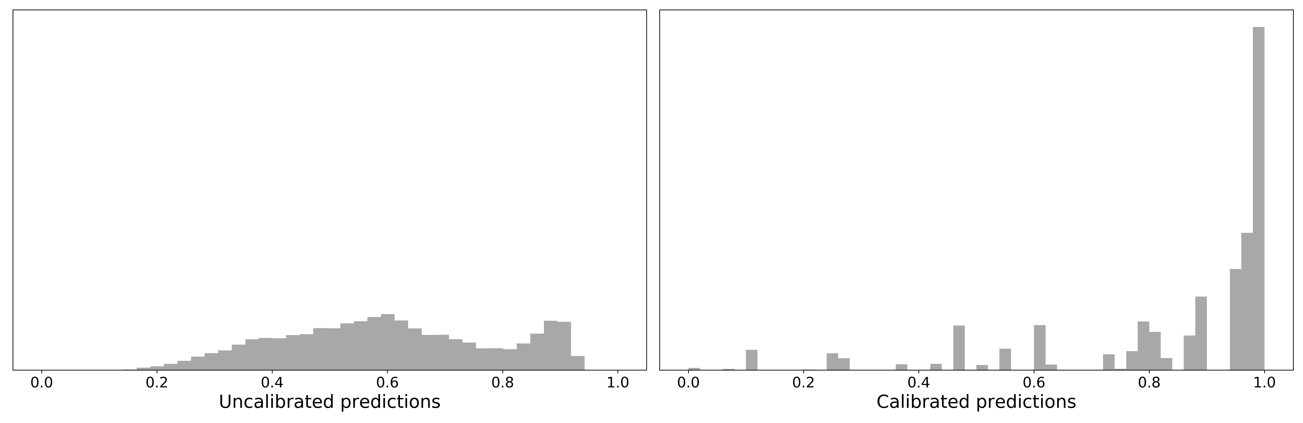


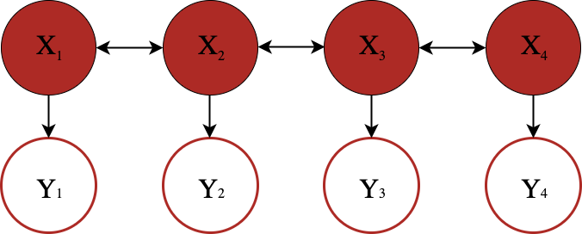
Estimating Off-Street Parking in Somerville
Joshua Feldman, Lipika Ramaswamy, Anthony Rentsch AC297r, Institute for Applied Computational Science, Harvard University
In collaboration with
INTRODUCTION
METHODS
RESULTS
The city of Somerville is conducting a comprehensive audit of parking. This includes on-street parking, parking garages, and residential off-street parking.
We contributed to this audit by estimating the city’s off-street, residential driveway parking capacity and providing an inventory of driveways.
Machine learning with administrative data
Framed the problem as a classification task. Classifiers implemented include Logistic Regression (with and without higher order terms), Random Forest, AdaBoost, XGBoost and Feed Forward Neural Network.
Class Imbalance: Only 16% of hand labelled parcels did not contain a driveway. For model training, the minority class was upsampled to synthetically obtain balanced classes.
Best performing model: Random Forest with no bootstrapping, a max tree depth of 6, and 256 estimators (found through cross validation grid search).
Deep learning with image data
Framed the problem for convolutional neural networks to predict driveways from satellite and/or street view images.
Attempted to train models with randomly initialized weights and using transfer learning with weights learned from aerial imagery.
Highly unsuccessful due to limited labels, poor signal from low quality satellite images, and ambiguity in street view images.
A well-calibrated probability is one that reflects the true likelihood of an event.
Since many machine learning models produce scores that are not well calibrated, a recalibration step was performed to turn raw model scores into well-calibrated probabilities.
Estimating uncertainty is complicated by spatial correlation
We assume that conditional on observed covariates X, the presence of a driveway Y is independent from parcel to parcel.
MODELLING
Test set: | Precision | Recall | F1 Score | Support
Driveway | 0.78 | 0.82 | 0.80 | 1179
No Driveway | 0.81 | 0.77 | 0.79 | 1179
GOAL: Predict probability of each parcel having a driveway
Feature Importance
DATA
Parcel and building polygons
Administrative tabular data:
Property tax assessment
Parking permits by street address
FEATURE DATA SOURCES
There are 11,704 residential parcels in Somerville.
Engineered features proved extremely important to achieving high precision and recall
LABELLING DATA SOURCES
Aerial Imagery (MassOrtho Imagery 2015)
Google Street View
POST-MODELLING
Probability calibration
Predicted block level proportion of driveways
✔
Labelled as having a driveway
We labelled 6,480 residential parcels to indicate whether or not they have driveways.
FEATURE ENGINEERING
Geometric Features
Distance from building to side 1, side 2, front, and back of parcel
Number of buildings
How much closer building is to one side of parcel and to front of parcel
Number of edges in parcel and building polygons
Distance to nearest neighbors
Simplify parcel and add midpoints
Calculate Features
ESTIMATION
Other Features
10,191 ± 63
parcels with driveways
Ratio of building area to lot area
Number of parking permits registered per address
Total number of features:
175
Note: All data is publicly available via Google or Somerstat: Somerville’s Open Data Repository.
Notes:
1

